Slide 1
BUILD
WITH
भारत 5.0
NATIONAL LEVEL HACKATHON
TEAM NAME:
The Revolutionaries
PROBLEM STATEMENT:
VISTA – Semantic Search for Medical Reports using Box-Clustering
TEAM MEMBERS:
Aditi, Ankit, Anant, Ansh
COLLEGE:
Pranveer Singh Institute of Technology, Kanpur
Notes:
Introduce team The Revolutionaries from PSIT Kanpur and the problem we picked: VISTA, semantic search for medical reports using box-clustering.

Slide 2
PROBLEM STATEMENT
BACKGROUND
Why keyword search fails
Hospitals generate millions of unstructured reports every year (discharge summaries, lab, radiology and prescriptions), often trapped in fragmented folders and legacy silos.
Query: “Heart Attack”
KEY ISSUES
Exact keyword match
1
Keyword dependency: exact match misses synonyms, e.g. “Heart Attack” vs “Myocardial Infarction”.
2
Slow retrieval: finding historical reports takes minutes and delays diagnosis.
✓ Found
“heart attack”
✗ Missed
“Myocardial Infarction”
3
Fragmented history: reports are scattered across departments, so there is no holistic patient view.
Same meaning, different words
4
Poor scalability: manual retrieval is inefficient and error-prone as data lakes grow.
Fragmented data silos
Folder A
Folder B
Folder C
5
High compute cost: embedding every document is expensive to scale.
Result: minutes to retrieve a single report
Core problem: How can we retrieve medical reports by meaning, while keeping computational cost low for large-scale hospital data?
Notes:
Keyword search finds 'heart attack' but misses 'myocardial infarction'. Reports sit in silos, so doctors lose minutes. Existing semantic search embeds every document, which is costly.

Slide 3
SOLUTION
VISTA (Vector Intelligent Semantic Search & Text Analysis) is a semantic healthcare data warehouse that retrieves medical reports by their clinical meaning, not just keywords.
BUILD TIME · one-off batch pipeline
Medical reports
(PDF, scans, TXT)
OCR + cleaning
MiniLM embeddings
(384-D)
Box-Clustering
(K-Means)
One summary
vector per box
Compact FAISS
index
QUERY TIME · per search
Doctor’s query
Embed query
Nearest boxes
(FAISS lookup)
Rerank by similarity,
then priority
Ranked results
Semantic retrieval
Box-Clustering
Faster search
Compute efficiency
Priority-based results
Understands context and medical synonyms.
Similar reports grouped into semantic “boxes”.
Design target: under 2 s per query (benchmark pending).
98.8% fewer indexed vectors on our test run.
Cosine first; freshness, usage and importance break ties.
Working idea: a doctor enters “Elevated Troponin, Acute Myocardial Infarction”; VISTA surfaces the top-priority file.
Expected impact: past cases in seconds, not minutes; larger archives searched on modest hardware; PII kept out of the vector index.
Notes:
Two phases. Build time: reports go through OCR and cleaning, MiniLM embeddings, K-Means box-clustering, one summary vector per box, and a compact FAISS index. Query time: embed the query, find the nearest boxes in FAISS, then rerank the reports inside them by cosine similarity, with freshness, call frequency and importance breaking ties. Expected impact: doctors reach similar past cases in seconds, hospitals search larger archives on modest hardware, and PII stays in the relational store. The 98.8% reduction is measured on the saved 1,000-report run; the under-2-second latency is a design target and is not benchmarked yet.

Slide 4
FLOW OF SOLUTION
INGEST &
PREPARE
1
Data Ingestion
2
Cleaning & Deduplication
3
OCR Extraction
Raw reports (PDF, images, TXT) collected through the ETL pipeline.
Remove corrupt, duplicate and malformed files for data quality.
PaddleOCR reads scans; PyMuPDF parses digital PDFs.
STORE &
ANALYSE
4
Storage
5
Metadata Analytics
6
Text Vectorization
Raw files in MinIO; metadata in Neon, linked by document_id.
DuckDB computes freshness and call frequency for priority scoring.
all-MiniLM-L6-v2 turns cleaned text into 384-D vectors.
CLUSTER &
SERVE
7
Similarity & Clustering
8
Box Summary & Indexing
9
Semantic Retrieval
Cosine similarity, then K-Means groups reports into semantic boxes.
Summarise each box; index only box embeddings in FAISS.
Query → nearest boxes → rerank by cosine, then priority.
Steps 1–8 run as an offline batch; step 9 runs on every search.
Notes:
Nine steps in three phases. Everything up to the FAISS index is a batch job; retrieval is the only online step.

Slide 5
TECH STACK
1
USER INTERFACE
Streamlit workspace
Technician: upload, monitor
Next.js workspace (planned)
Doctor: search, read
Box Explorer + Analytics
Cluster map, quality metrics
2
API LAYER
Ingestion API
FastAPI · Python
Clustering API
FastAPI · Python
Search API
FastAPI · Python
3
PROCESSING PIPELINE
OCR & parsing
PaddleOCR · PyMuPDF
Clean & deduplicate
Quality filter
Embeddings
Sentence Transformers · 384-D
Box-Clustering
K-Means + cosine
4
SEMANTIC INDEX
FAISS flat index
Box summary vectors only
Priority Score
Freshness + call frequency
Box → files map
Ranked inside each box
5
DATA LAYER
MinIO (S3)
Raw PDFs, images, TXT
Neon PostgreSQL
Metadata via document_id
DuckDB
Usage analytics
6
DEVOPS
Docker · Docker Compose
Containerised, reproducible deployment
Open-source batch pipeline
Runs locally; Neon free tier
Notes:
Six layers: UI, API, processing pipeline, semantic index, data layer and DevOps. Streamlit is the working prototype UI and a Next.js doctor workspace is planned. Only box summary vectors enter FAISS; raw files stay in MinIO and metadata in Neon.

Slide 6






UNIQUE SELLING PROPOSITION (USP)
CORE USP
Meaning over keywords
Compute-efficient & scalable
Box-Clustering over per-document indexing
Understands clinical terms and synonyms, whatever the phrasing.
Smaller FAISS index and lower search cost; runs on modest hardware.
“Fewer, richer vectors” instead of “many, compressed vectors”.
Traditional flat index
1,000 document vectors
Priority-aware retrieval
Metadata-first privacy
VISTA box index
Similarity first; freshness, call frequency and importance break ties.
PII stays in Neon; only box-level summaries enter vector space.
12 box vectors
98.8%
fewer indexed vectors (1,000 → 12 on our test run)
Hybrid intelligence
Open-source & low-cost
Semantic search, clustering and analytical scoring in one warehouse.
Free tools, local Docker deployment, Neon free tier.
Saved test run; the prototype now holds 7,248 reports in the same 12 boxes. Recall@k vs a flat index is next.
Notes:
The core innovation: index one richer summary vector per semantic box rather than every report. On the saved 1,000-report run that is 1,000 flat vectors versus 12 box vectors, 98.8% fewer; the prototype now holds 7,248 reports in 12 boxes. Recall@k versus a flat index has not been benchmarked yet and no recall figure is claimed.

Slide 7
FEASIBILITY & COMPETITORS
TECHNICAL
ECONOMIC
OPERATIONAL
HARDWARE
Highly feasible
Cost effective
Pragmatic
Research-ready
Open-source, well-documented tools; working prototype built.
Mostly free tools; local Docker plus Neon free tier.
Batch ingestion fits existing hospital archives.
Box-level indexing keeps memory and compute low.
CHALLENGES & MITIGATION
COMPETITOR LANDSCAPE
Cluster quality and missed reports
COMPETITOR | TYPE | VS. VISTA
Elasticsearch (semantic + vector) | General-purpose search | Per-document vectors mean a much larger index; no box-clustering.
Google Vertex AI Search (Healthcare) | Enterprise cloud | Managed and healthcare-focused, but costly and closed source.
Pinecone / Weaviate / Milvus | Vector databases | Scale well, but no integrated ETL, OCR, clustering or priority scoring.
OpenEvidence | AI clinical search | Searches medical literature; VISTA searches internal hospital reports.
VISTA (ours) | Semantic warehouse | OCR → box-clustering → priority ranking in one open-source, local stack.
Boxes overlap (silhouette 0.0443) yet purity is 95.5%. Rerank inside top boxes, tune K and benchmark Recall@k.
OCR noise on poor scans
Cleaning, deduplication and cached OCR before embedding.
De-identification and rollout
De-ID is not built yet: pilot on de-identified data with clinician review before any clinical use.
Notes:
Technically and economically feasible with open tools. Main risks: cluster quality (boxes overlap but follow specialties), reports outside the top boxes being missed, OCR noise, and de-identification not yet built. Rollout: prototype on public MTSamples data, benchmark latency and Recall@k, pilot on de-identified hospital data with clinician review, then expand after privacy and compliance validation.

Slide 8
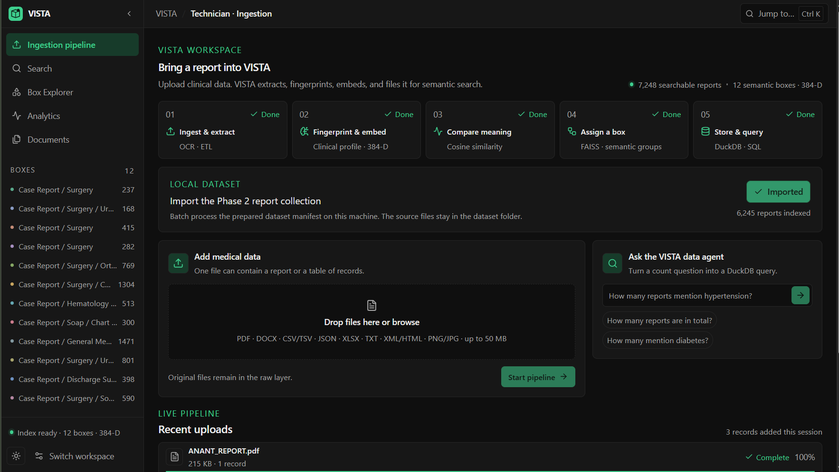
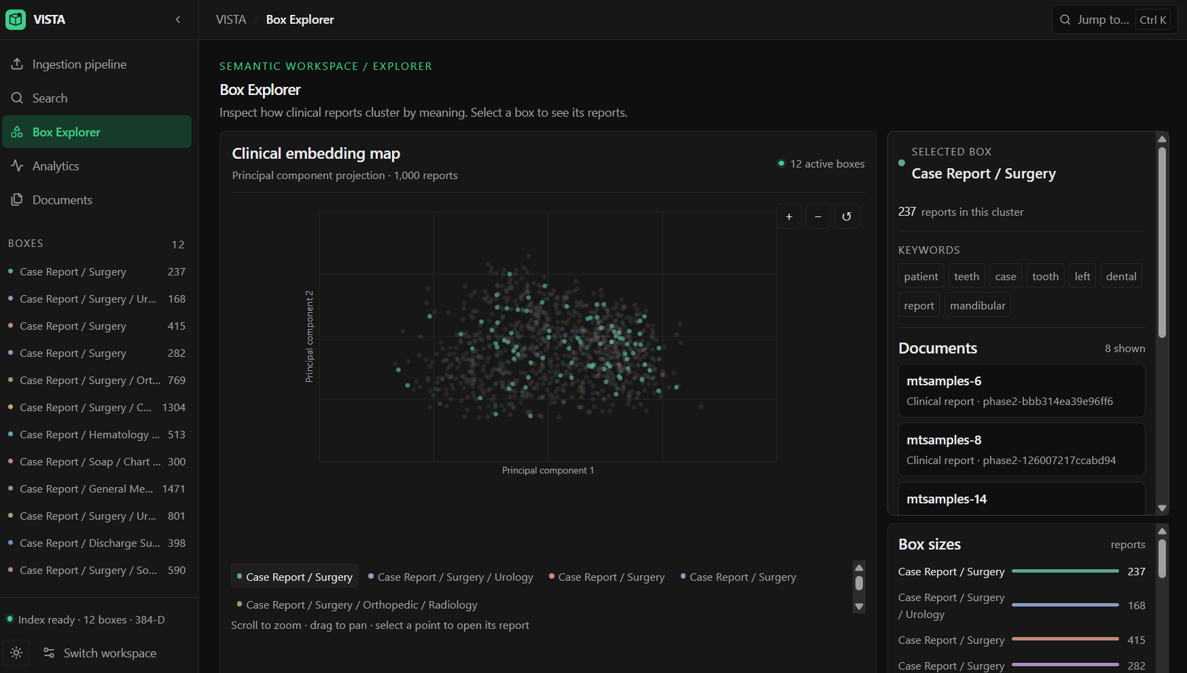
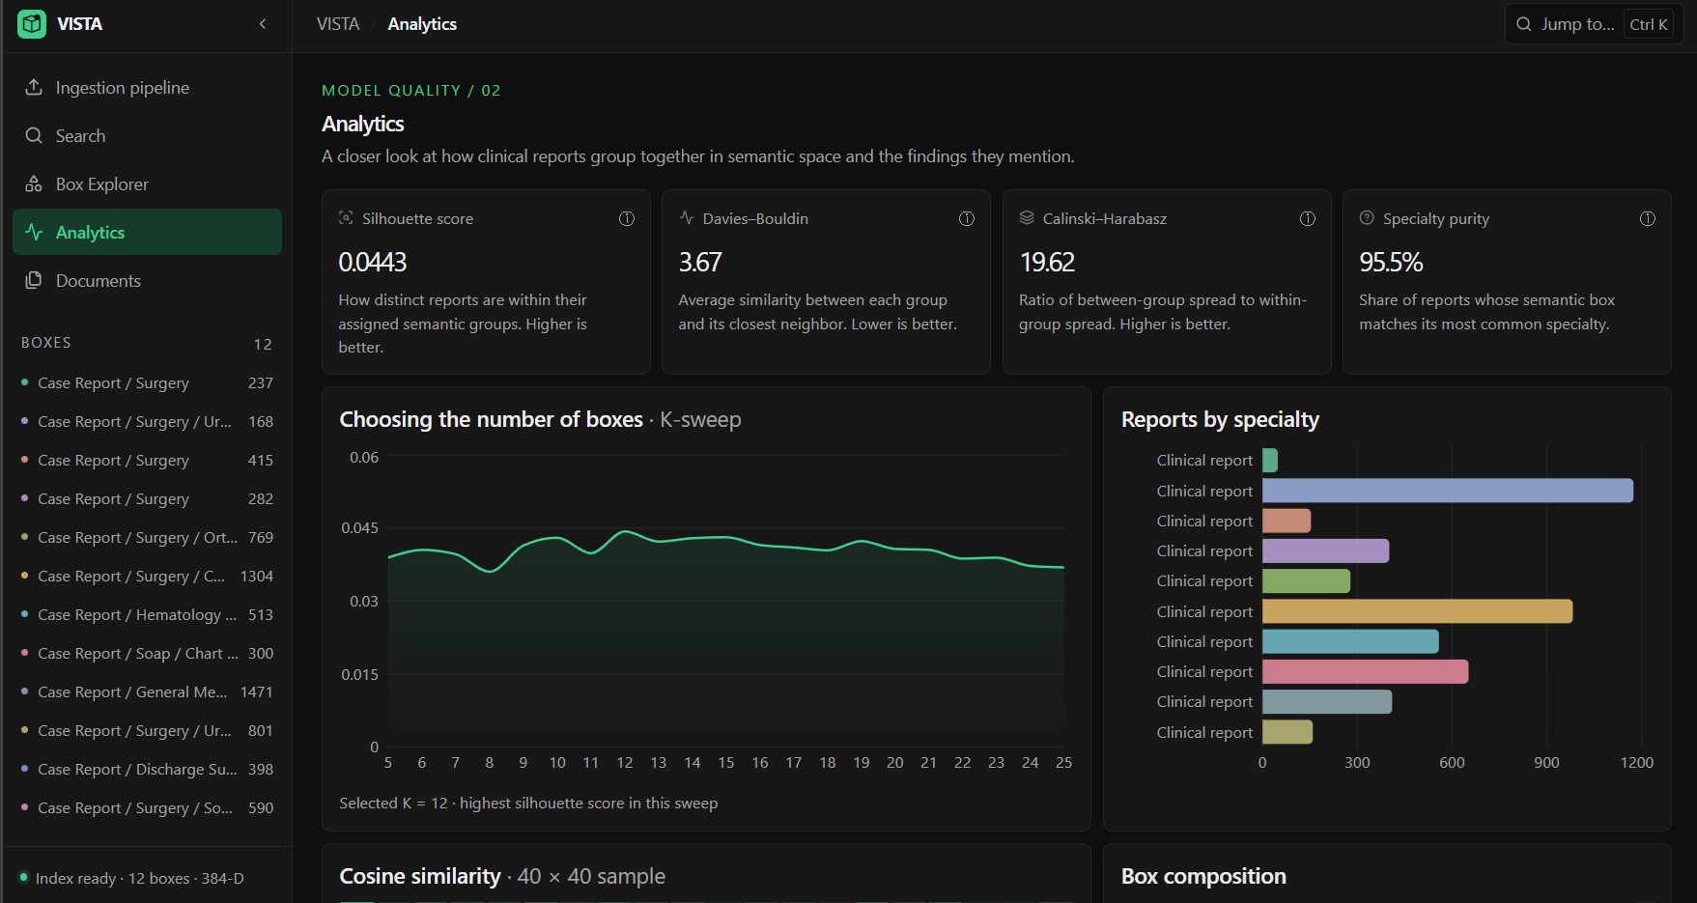


PROTOTYPE
Ingestion: upload a report, 5-step pipeline, data agent
Box Explorer: 1,000-report test run, 12 boxes
Analytics: K = 12 chosen by sweeping K from 5 to 25
0.0443
3.67
19.62
95.5%
Boxes overlap (low silhouette) but still follow specialties (95.5% purity). Recall@k vs a flat FAISS index is our next benchmark.
Silhouette
Davies–Bouldin
Calinski–Harabasz
Specialty purity
Working prototype: 7,248 searchable reports in 12 semantic boxes (384-D index) · Code: github.com/anshxgaur/VISTA
Notes:
Real screenshots from the working prototype: the ingestion screen (upload any report, a five-step pipeline, and a data agent that turns count questions into DuckDB queries), the Box Explorer projection of the 1,000-report test run, and the Analytics screen. Silhouette 0.0443 means boxes overlap, as expected for clinical text, but 95.5% specialty purity shows they still follow medical specialties. The prototype now holds 7,248 reports in 12 boxes. Recall@k versus a flat FAISS index is the next benchmark and no recall figure is claimed.

Slide 9

RESEARCH & REFERENCE
RESEARCH BASIS
Semantic similarity: cosine distance removes document-length bias.
CODE & DEMO
1
github.com/
anshxgaur/VISTA
2
Efficient clustering: K-Means groups medical text by latent meaning.
3
Vector search: FAISS is fast; the box-first approach shrinks the search space.
Scan to open the code. Working prototype screenshots on slide 8.
4
Lightweight embeddings: all-MiniLM-L6-v2 balances accuracy and speed.
5
Data lake architecture: object storage, warehouse, analytics and a vector layer.
REFERENCES
7,248
12
[1] Johnson, J., Douze, M., & Jégou, H. (2019). Billion-scale similarity search with GPUs. IEEE Trans. on Big Data.
[2] Reimers, N., & Gurevych, I. (2019). Sentence-BERT: Sentence Embeddings using Siamese BERT-Networks. EMNLP.
[3] MTSamples. Medical Transcription Samples Dataset.
[4] PaddlePaddle. PaddleOCR: Awesome multilingual OCR toolkits (GitHub).
[5] MinIO. High Performance Object Storage (Documentation).
[6] Neon. Serverless Postgres (Documentation).
[7] DuckDB. An in-process SQL OLAP Database (Documentation).
searchable reports
semantic boxes
384-D
95.5%
embedding index
specialty purity
VISTA: find reports by meaning, with far fewer vectors. Thank you! · The Revolutionaries, PSIT Kanpur
Notes:
Close with the repository and QR code, thank the judges, and invite questions.

